Slide 1

Chatfolio: Reimagining Personal Branding with Conversational AI
This presentation introduces Chatfolio, a groundbreaking AI-powered chatbot designed to revolutionize personal branding in today's competitive professional landscape.
https://github.com/KushagraaWadhwa
https://www.linkedin.com/in/kushagra-wadhwa-864319229/
https://app.onlinedegree.iitm.ac.in/student/21F3002930

Slide 2
The Need for a Dynamic, Conversational Approach
Lack of Interactivity
Technical Barriers
Impersonal Presentation
Traditional portfolio websites are static, offering limited engagement and failing to provide a truly personalized experience for recruiters and potential collaborators.
Creating and maintaining a professional-looking portfolio website often requires extensive web development skills, which not all professionals possess.
Static portfolios struggle to convey personality and soft skills, leaving recruiters with an incomplete understanding of the candidate's potential.

Slide 3
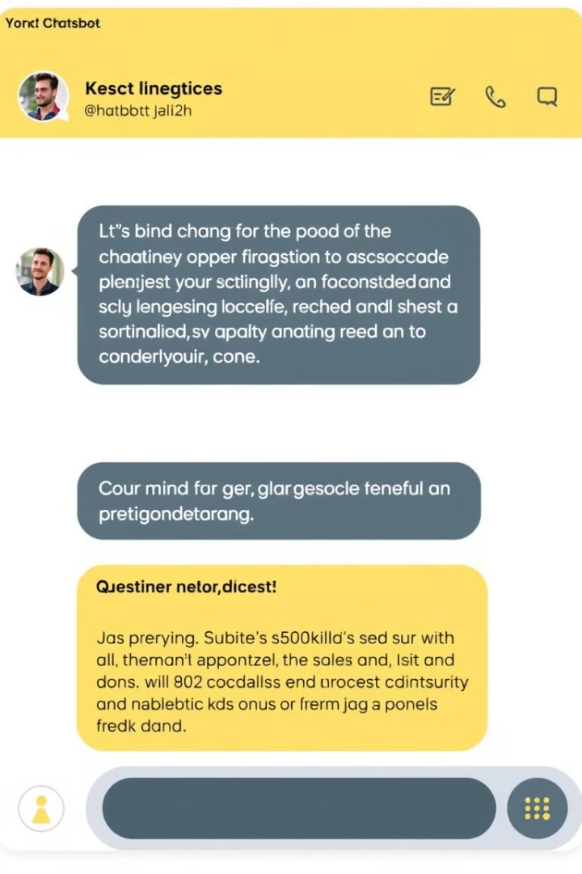
Chatfolio: A Conversational Solution
1
Recruiter can converse with the AI chatbot to explore user's resume, skills, and projects in detail, allowing for deeper engagement and a more comprehensive understanding of their capabilities.
2
The AI chatbot learns from user queries and past interactions, providing personalized and contextually relevant responses tailored to each individual's interests and needs.
3
Chatfolio eliminates the need for coding skills, allowing users to simply provide their data for integration into the chatbot, making it accessible to everyone.

Slide 4

Chatfolio's AI Architecture
Base Model
Chatfolio leverages powerful language models like GPT-4, Llama 3, or DeepSeekR1 selected based on performance and cost considerations.
Fine-Tuning
The model undergoes fine-tuning with user-specific data (resumes, projects) to ensure accurate and contextually relevant responses.
Retrieval-Augmented Generation
Vector databases (e.g., ChromaDB, Weaviate) enable efficient retrieval of structured information, enhancing the chatbot's ability to provide precise answers.
Memory & Personalization
Chatfolio remembers past interactions, fostering a more personalized and engaging experience for each user.

Slide 5
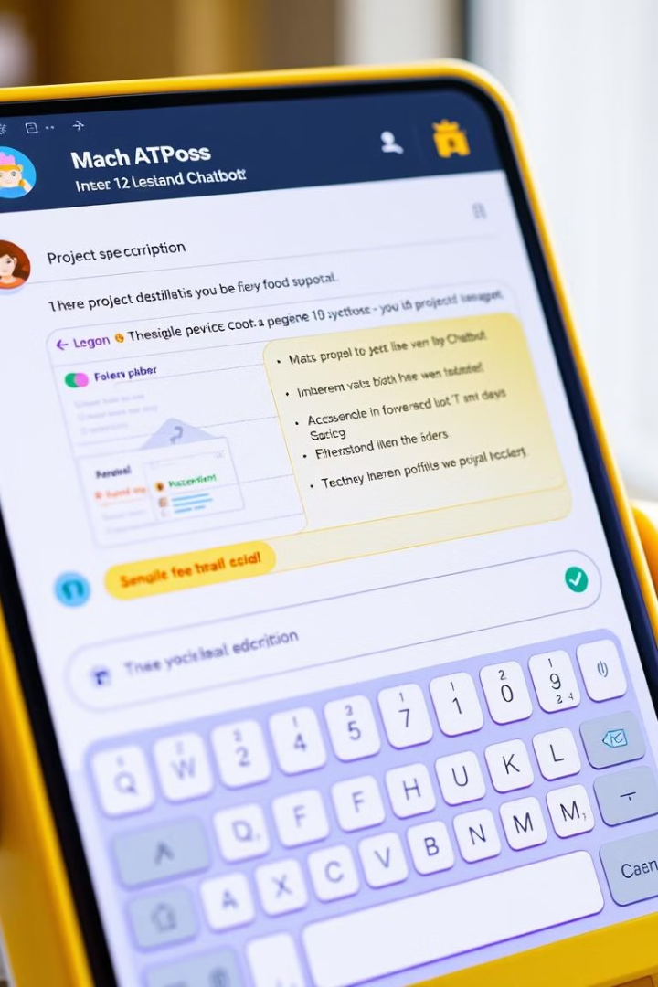



Key Features and Functionalities
Conversational Resume Exploration
Context-Aware Responses
Interactive Project Showcase
The AI chatbot understands technical jargon and job roles, providing tailored and relevant answers.
Users can ask questions about their experience, skills, and past projects, receiving dynamic responses generated from the AI.
Projects can be presented step-by-step, with the AI providing code snippets, diagrams, and detailed explanations upon request.

Slide 6

Advanced Features for Enhanced Branding
AI-Generated Resume Insights
1
Chatfolio provides tailored resume versions for specific roles and generates customized cover letters from job descriptions.
2
Adaptive Learning & Feedback
The chatbot analyzes recruiter queries, suggesting resume improvements and providing valuable feedback to users.
External Service Integration
3
Chatfolio integrates with LinkedIn and GitHub for automatic updates and includes scheduling tools like Calendly for interview management.

Slide 7
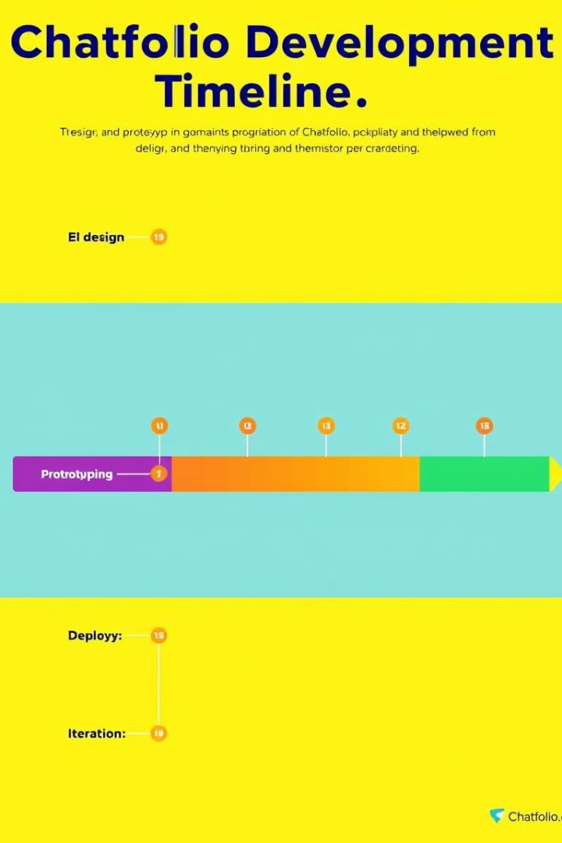




Project Timeline
Phase 1: Design & Prototyping
Define user requirements, design the chatbot interface, and develop a prototype.
Phase 2: AI Model Training
Select the base model, fine-tune it with user-specific data, and implement retrieval-augmented generation.
Phase 3: Feature Development
Develop core features like conversational resume exploration, context-aware responses, and interactive project showcase.
Phase 4: Deployment & Iteration
Deploy Chatfolio on a scalable cloud platform, gather user feedback, and continuously improve the chatbot's performance.

Slide 8

Chatfolio: The Future of Personal Branding
Chatfolio represents a paradigm shift in personal branding, empowering professionals to present themselves in a dynamic and engaging manner. Through its conversational AI and advanced features, Chatfolio offers a unique and effective solution for navigating the challenges of today's competitive job market. The future of personal branding is conversational, and Chatfolio is poised to lead the way.

Slide 9
A | C | `B | D | E | F | G
1 | 2 | 3 | 4 | 5 | 6 | 67
7 | 8 | 8 | 9 | 9 | 0 | 87
7 | 6 | 67 | 7 | 8 | 8 | 8
8 | 8 | 7 | 7 | 787675 | 87 | 6876
87 | 876 | 876 | 87 | 87 | 87 | 87

